Slide 1
Cir Patch Feed Disk Yagi
Student Edition
SOFTWARE
Data Acquisition
Averaging
Auto File Saving

Slide 2
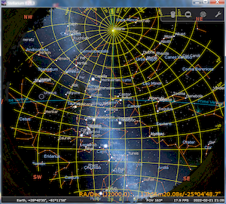
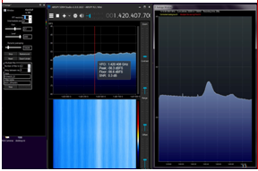
Basic Software Hydrogen 21 cm Radio Telescope
H Line Acquisition :
Air Spy
SDR Sharp Studio
IF Average Plug-In
find the Milky Way
Planetarium Software
Astronomical Sky Display
Stellarium
a pettit jr Aug24

Slide 3
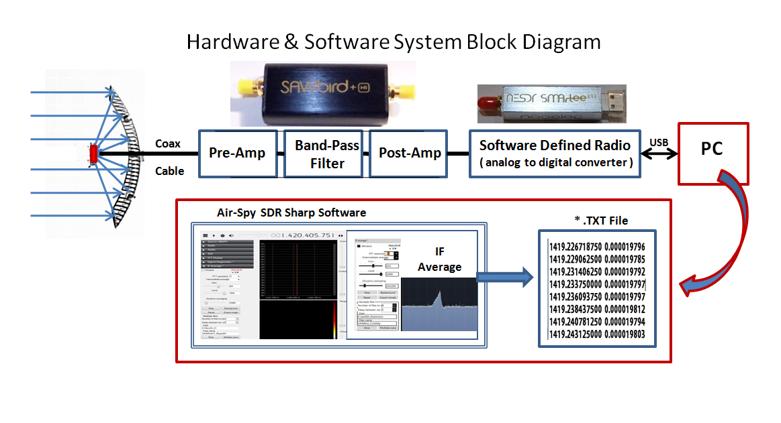
System Hardware and Software

Slide 4
SOFTWARE AirSpy SDR# Studio
IF_Ave Ver 2.8 PlugIn for SDR# Studio
Full Installation of SDR# & IF_Ave 2.7
https://www.dropbox.com/scl/fi/2f67lyu6qgt2cp98rg9kp/SDR-2.ZIP?rlkey=y82yv6jzjyu7e92sap3x8ewm7&st=tcil7w3s&dl=0
The latest Rev of IF_Ave allows
Saving and Recalling named Background Correction Files
replace the above with this newer * DLL
IF_Ave Version 2.8
https://www.dropbox.com/scl/fi/aitn8xtookwwxm6mvybkp/SDRSharp.Average.dll?rlkey=667f4a83958krn77ie2862jxf&dl=0
a pettit jr Aug24

Slide 5
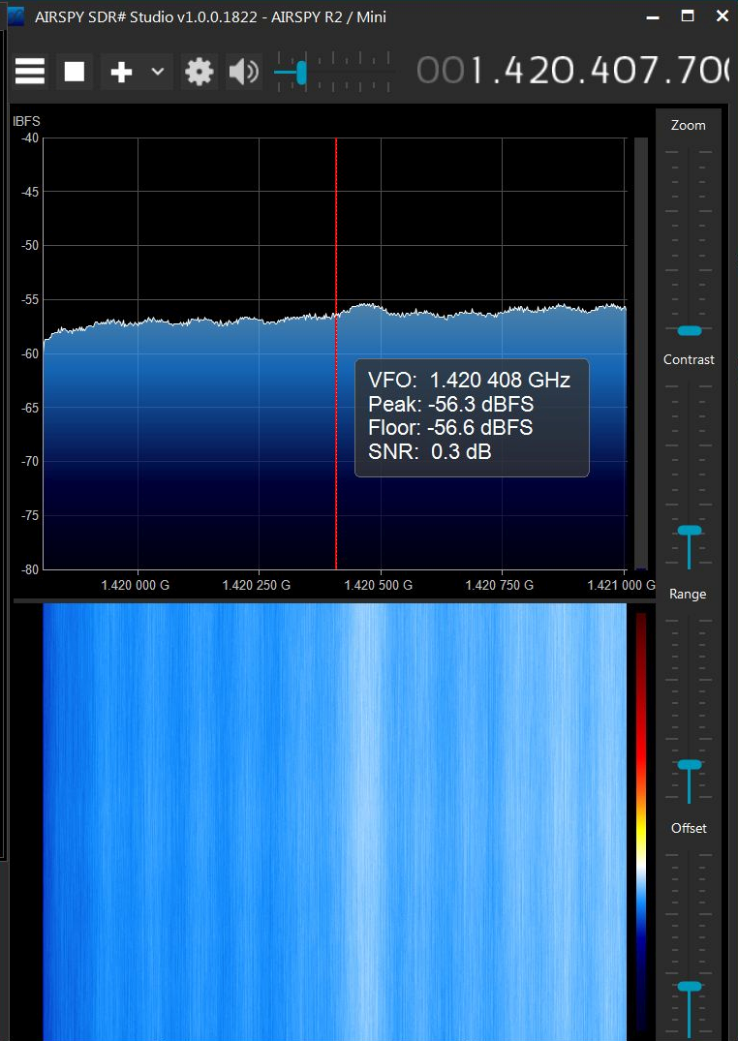
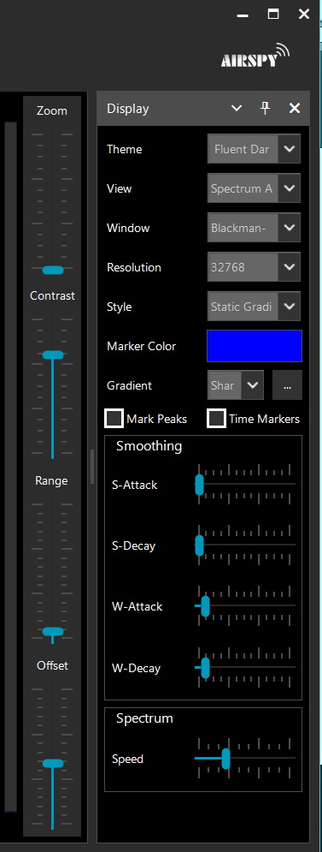
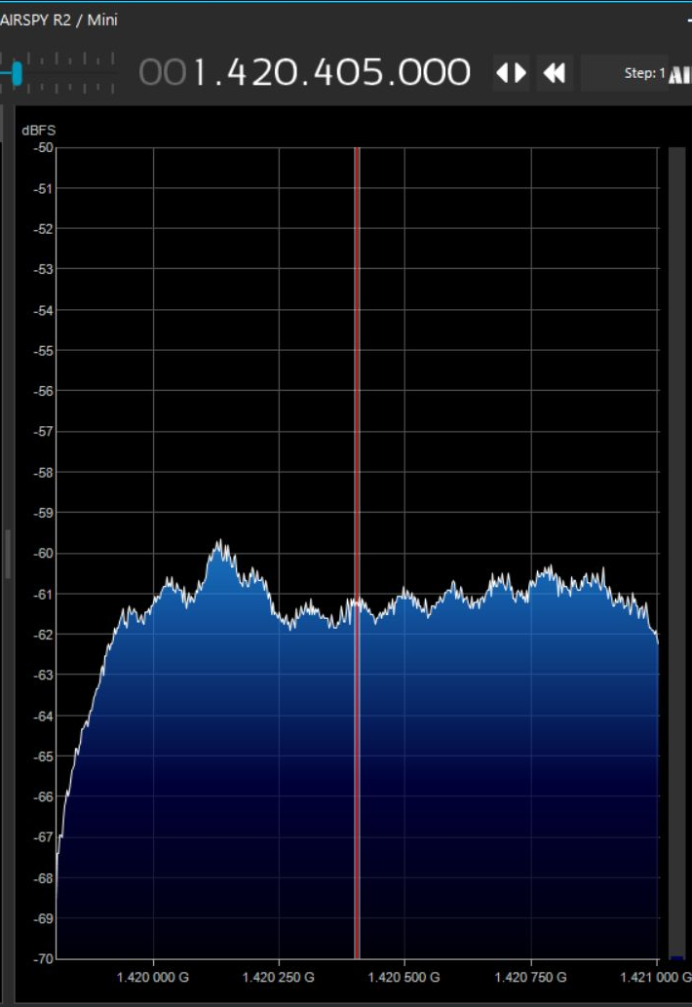
SOFTWARE AirSpy SDR# Studio
Control the SDR Software Defined Radio module
Real Time Spectral Display of Data
a pettit jr Aug24

Slide 6
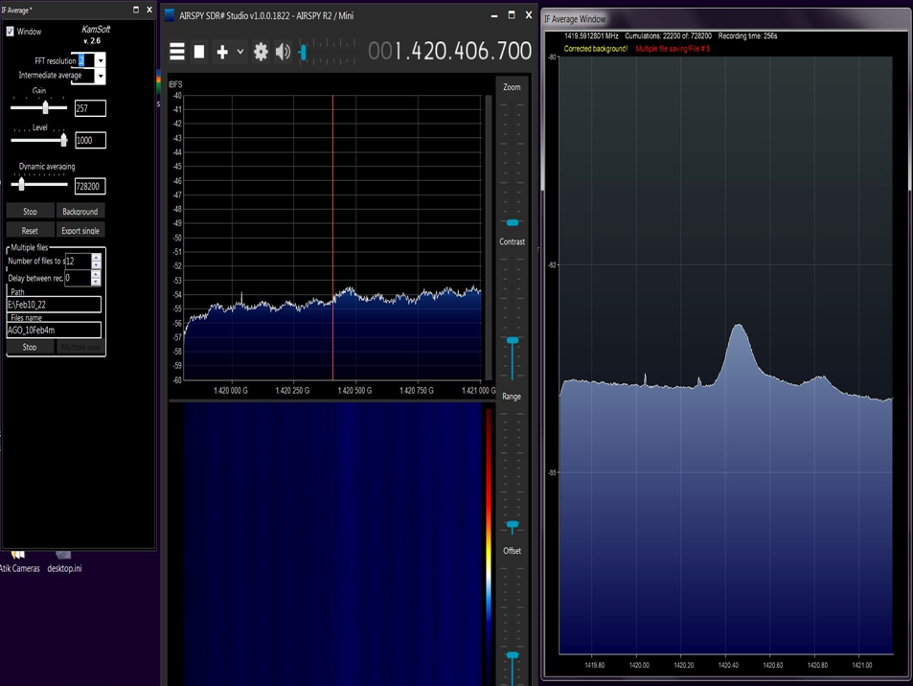
Software Block Diagram
Air-Spy SDR Sharp Software
AirSpy SDR# Studio
a pettit jr Aug24

Slide 7
Software Block Diagram
Air-Spy SDR Sharp Software
AirSpy SDR# Studio & IF Average

Slide 8
Software Block Diagram
Air-Spy SDR Sharp Software
AirSpy SDR# Studio & IF Average

Slide 9
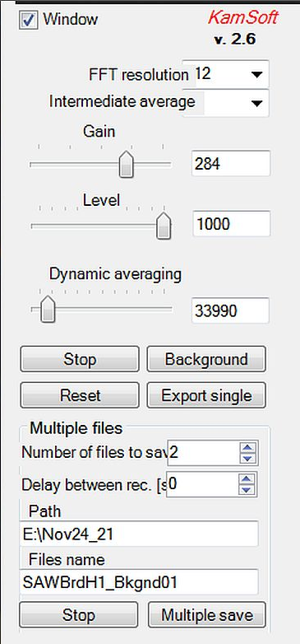
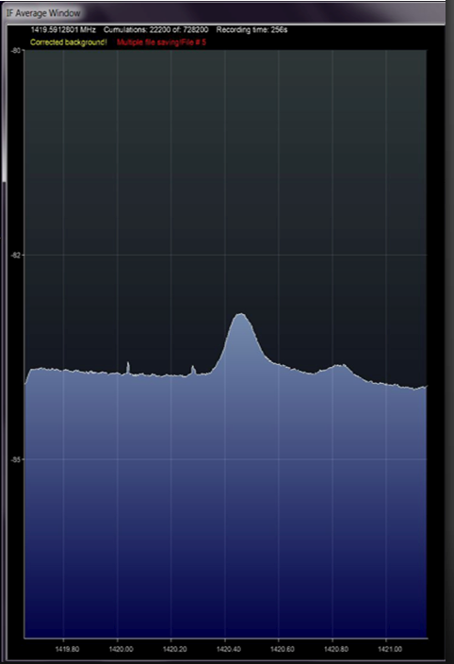
Software Block Diagram
IF_Average Plug-In for AirSpy SDR# Studio
512
1000
Set Up Display, FFT resolution and
Number of Averages
to View / Save
FFT resoluiton of 256 512 1024
compatible with HL3D processing

Slide 10
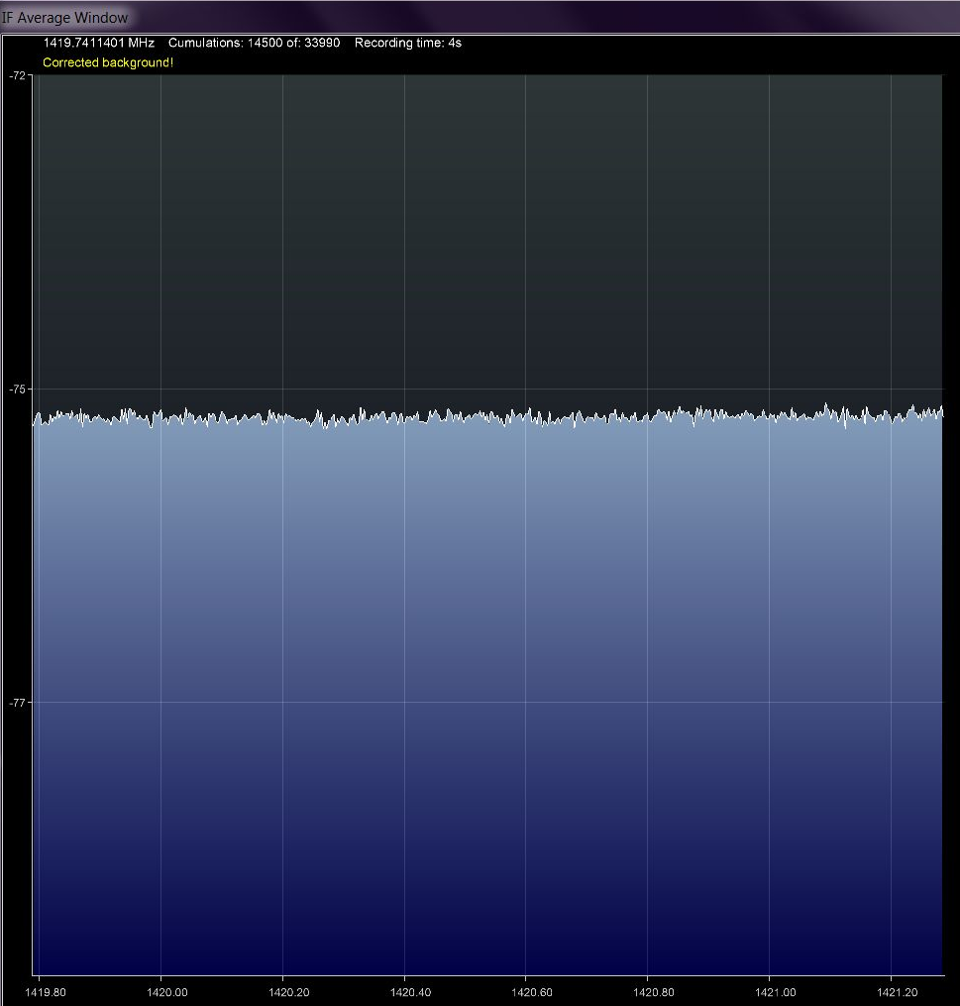
Software Block Diagram
IF_Average Plug-In for AirSpy SDR# Studio
512
Start / Stop acquisition
Create a Background Reference
Correction File
a pettit jr Aug24

Slide 11
Software Block Diagram
IF_Average Plug-In for AirSpy SDR# Studio
512
H1 Spectrum USING
Background Reference
Correction File
Start / Stop acquisition
Create a Background Reference
Correction File

Slide 12
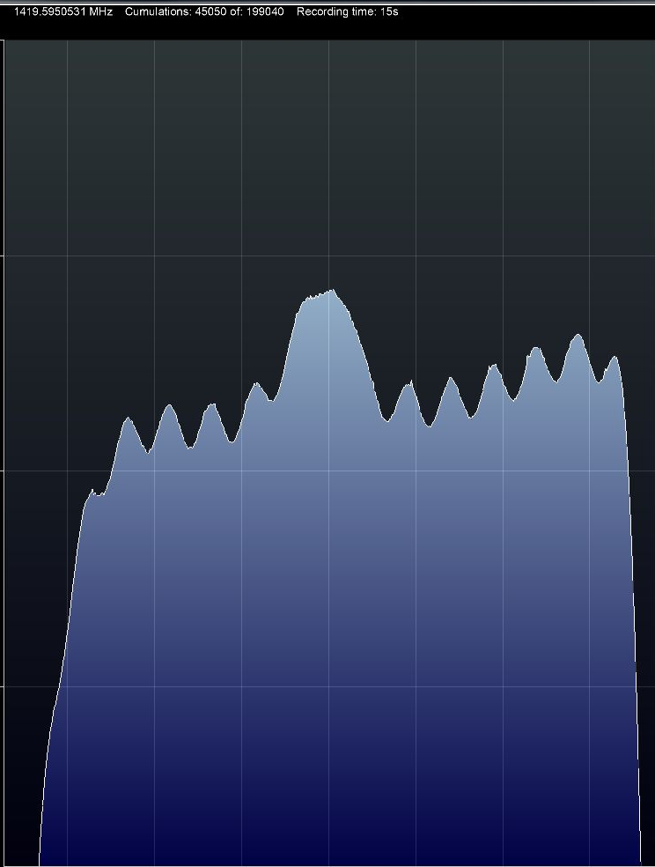
Software Block Diagram
IF_Average Plug-In for AirSpy SDR# Studio
512
H1 Spectrun WITHOUT
Background Reference
Correction File
a pettit jr Aug24

Slide 13
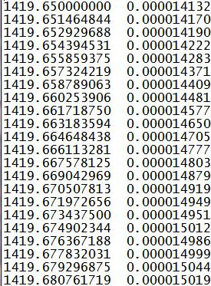
Software Block Diagram
IF_Average Plug-In for AirSpy SDR# Studio
512
* .TXT File
Create / Save Data_files

Slide 14
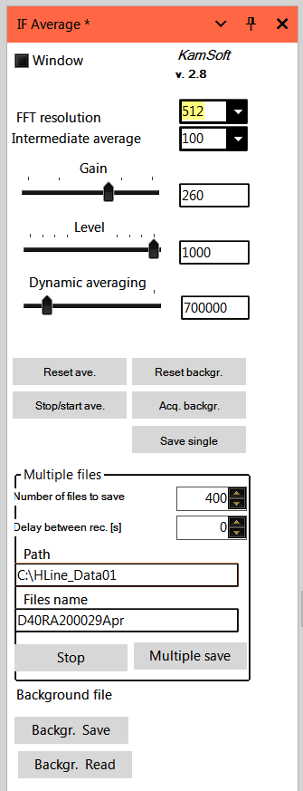
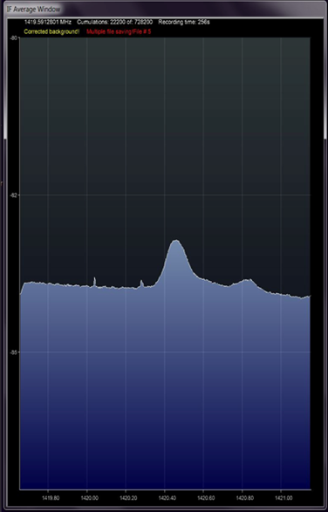
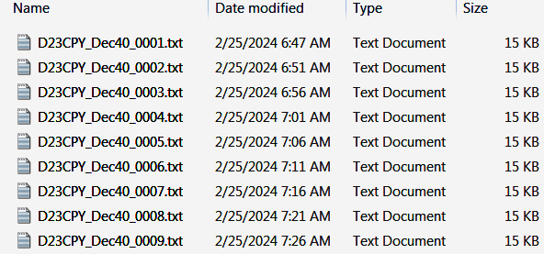
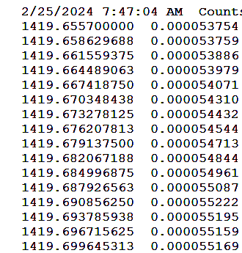
SOFTWARE AirSpy SDR# Studio
IF_Ave Ver 2.8 PlugIn for SDR# Studio
allows Setting Up Averaging, Creating a Background Correction File
and auto saving of a sequence of *.txt data files
Auto Saved Files
Freq/Ampl data columns in one file

Slide 15
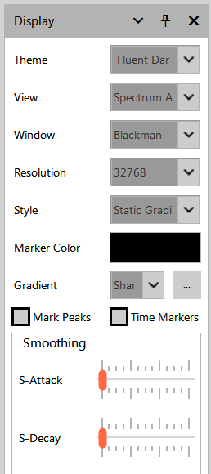
a pettit jr Aug24

Slide 16
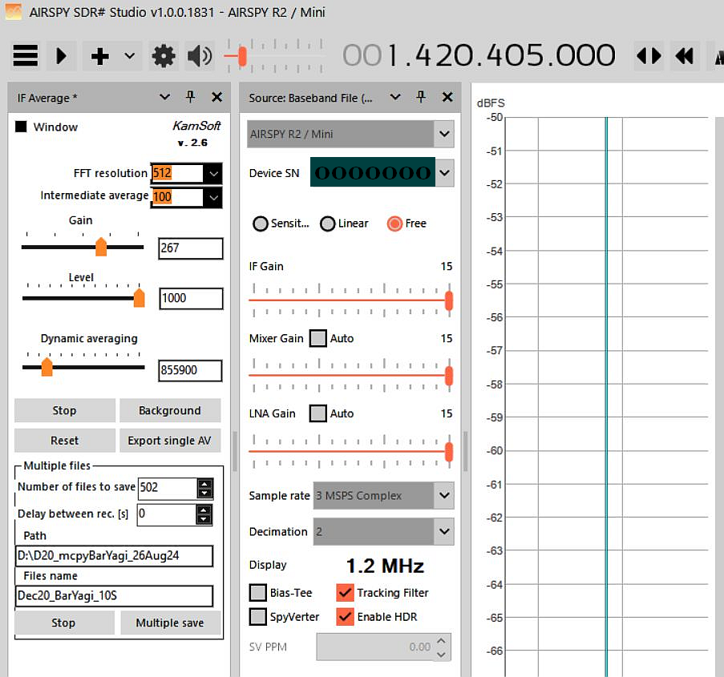
a pettit jr Aug24

Slide 17
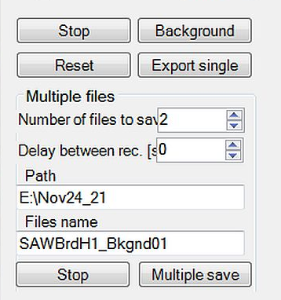
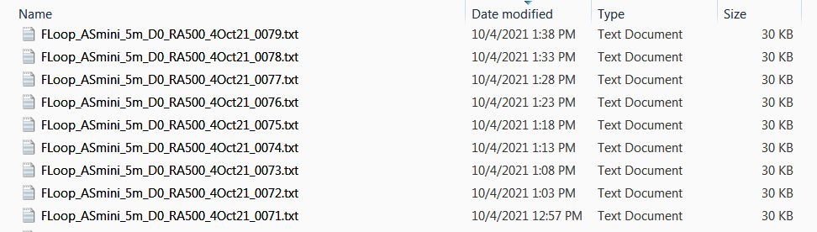
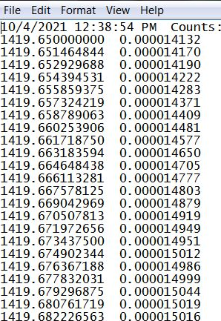
Allows FFT Size / High Count Averaging / Spectrum Saving at Selected Time Rates

Slide 18
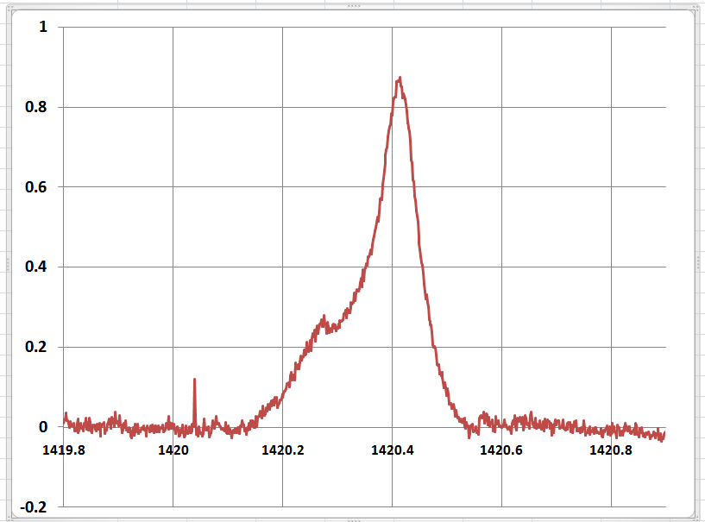
Hydrogen 21-cm wavelength RF Emission Spectrum
Hydrogen
RF Signal
1420.405751 MHz
+ Doppler Shift
dB Relative to Background Noise
Cold Sky
&
System Noise
RFI
Frequency MHz
a pettit jr Aug24

Slide 19
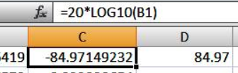
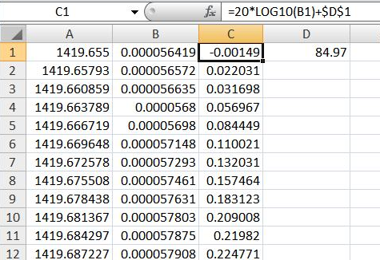
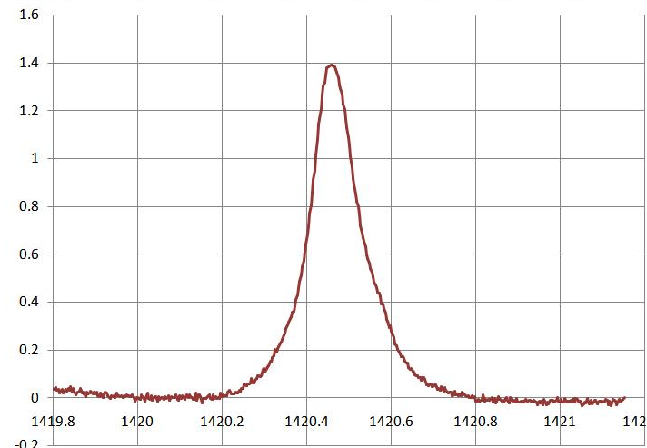
Hydrogen 21-cm wavelength RF Emission Spectrum
Convert col B to dB use the formula dB = 20*LOG10( col B values )
Then offset entire column by a fixed value to make Cold Sky == 0 dB ( in this case 84.97 )
When you first create col C, it has a large - dB value.
As a starting point put C1 value into Cell D1
Then add that fixed cell to all col C values ( C1 .. C512)
Finally, Adjust as req'd to shift the Y axis.
so Cold_Sky == 0 dB
a pettit jr Aug24

Slide 20
Hydrogen 21-cm wavelength RF Emission Spectrum
dB = 20* log10(data) + OFFSET
dB Relative to Background Noise
Frequency MHz
a pettit jr Aug24

Slide 21
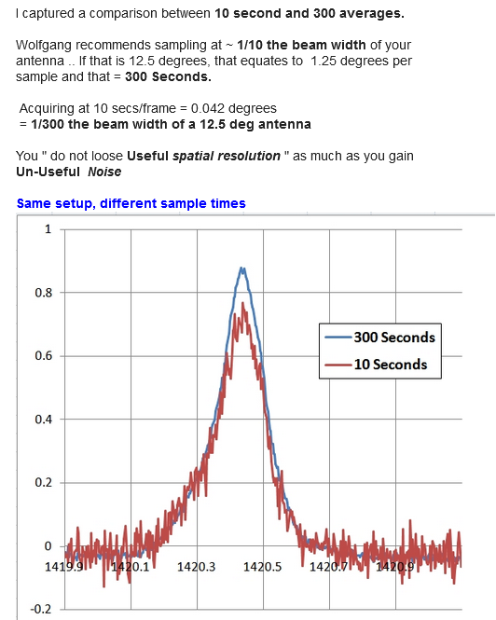

Slide 22
SOFTWARE Links misc info
https://www.rtl-sdr.com/cheap-and-easy-hydrogen-line-radio-astronomy-with-a-rtl-sdr-wifi-parabolic-grid-dish-lna-and-sdrsharp/
https://www.youtube.com/watch?v=C6NCefVxNL8
SARA 2022 Eastern Conference
Galactic Hydrogen 1.42 GHz RF Emission Radio Astronomy for $300 Alex Pettit
SARA www.radio-astronomy.org
The $300 SARA ‘Scope in a Box' Radio Telescope System and Beyond
A beginner's introduction into receiving and processing 1.42 GHz RF emission signals
from neutral hydrogen regions within the Milky Way Alex Petit
This presentation will briefly overview the history and value of radio astronomy. It will describe the Analog RF and Digital Signal hardware components and the basic software needed to acquire, process, and display the data. Drift Scan data recording will be explained, and several upgrades will be suggested for improvements in signal amplitude and quality.
a pettit jr Aug24

Slide 23
Radio Astronomy Presentations from the
Society of Amateur Radio Astronomers Eastern Conference July 2022
Introduction to Radio Astronomy
https://www.youtube.com/watch?v=AOgvjRXnins
Dr. Wolfgang Herrmann Keynote Amateur Radio Astronomy Possibilities and Limitations,...
https://www.youtube.com/watch?v=8j1bVpC6M94
Alex Pettit: Galactic Hydrogen 1.42 GHz RF Emission Radio Astronomy
https://www.youtube.com/watch?v=C6NCefVxNL8
a pettit jr Aug24

Slide 24
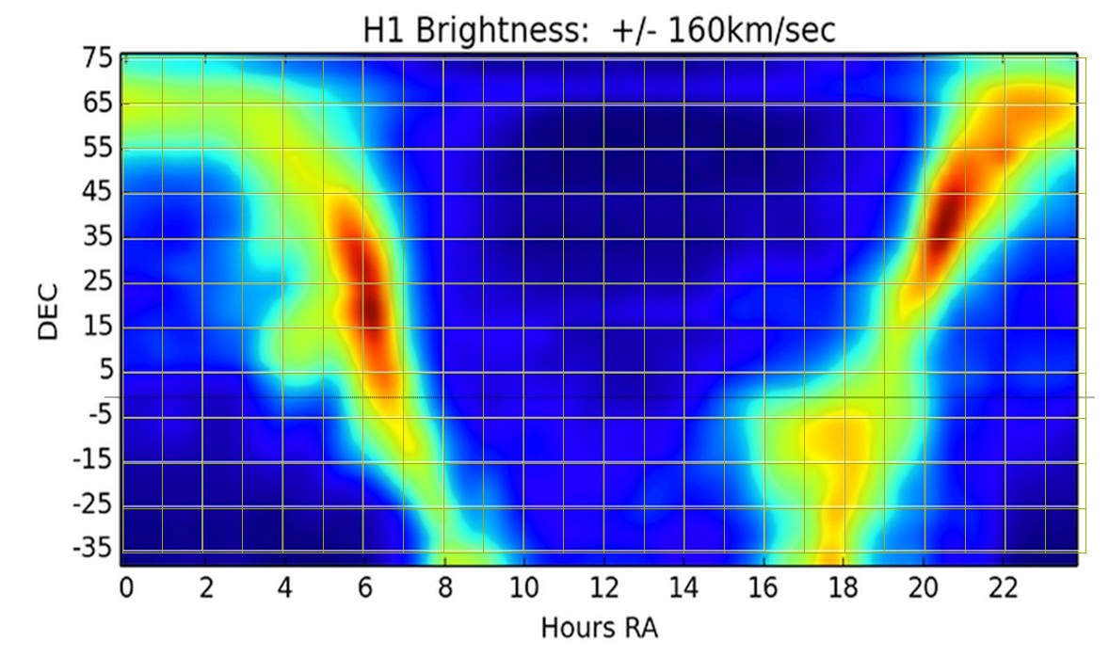
Milky Way 21cm Neutral Hydrogen Line Brightness Intensity Chart
With Permission Marcus Leech CCERA Canadian Centre Experimental Radio Astronomy

Slide 25
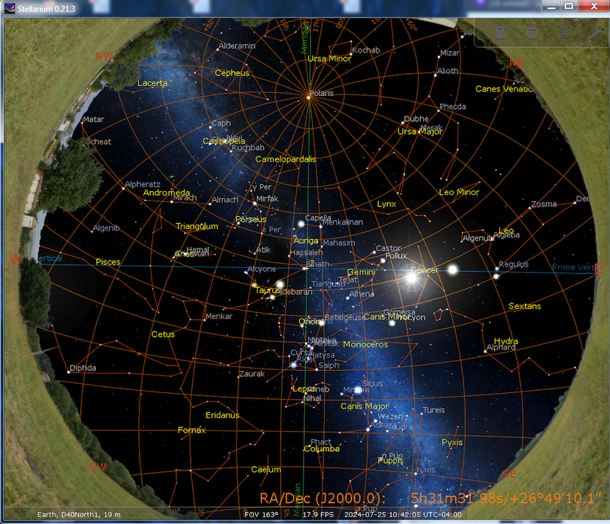
Stellarium Planetarium Program
find when Milky Way is overhead and RA Time
https://stellarium.org,
a pettit jr Aug24

Slide 26
